Slide 1



A Seminar
On
Cuff-Less Blood Pressure Estimation Using
Machine Learning
Blood pressure monitoring
made easy
Presented by,
Om Dandade (19)
Poorvi Kulkarni (35)
Pranita Kulkarni (36)
Under the guidance of,
Mr. Lokesh M. Giripunje
Assistant Professor
Department of Electronics and Telecommunication Engineering
Dr. D. Y. Patil Institute of Engineering, Management and
Research, Akurdi, Pune - 44
2021-2022
B.E. Sem I

Slide 2
Index
Abstract
Introduction
Comparison between available methods
Proposed system and working
Collecting data
Calculating PTT
Estimating BP
Expenditure incurred
Disadvantages, advantage and application
References

Slide 3
Abstract
Recently, wearable and smartphone health became promising due to their convenience, ubiquity, and the ability to gather data in real time for patients.
This project will focus on yet another method for monitoring BP, which will be non-invasive, portable, and cuff-less.
The system will estimate BP using pulse transit time (PTT) by measuring two separate photoplethysmogram (PPG) signals.
A Machine Learning model will predict the BP using PTT and other physiological parameters of a person.
Keywords
Hypertension, blood pressure, cuff-less, photoplethysmogram (PPG), pulse
transit time (PTT), Machine Learning (ML).

Slide 4
Introduction
Hypertension (or high blood pressure [BP]) is a significant health issue for adults that can result in serious complications, such as stroke and heart diseases.
There are huge number of people suffering from hypertension in India and globally also.
Also the patients of hypertension and dubieties are considered more vulnerable to Covid-19.
Hence, continuous BP monitoring of patients suffering from hypertension can prevent the progression of the hypertension and reduce medical costs.
And our solution brings a portable and convenient way to do the same.

Slide 5
Comparison between available methods
Method | Principle of working | Accuracy | Invasive | Portability
Catheterization | It involves placing a strain gauge in fluid contact with a patient’s blood | Most exact | invasive | Very Low
sphygmomanometer | Uses an inflatable cuff | Very Accurate | non-invasive | Low
Oscillometry | Requires a cuff | Accurate | non-invasive | High
Tonometry | Obtains the arterial waveform using sensors located on the artery sites | acceptable | non-invasive | Very Low
Using PTT | Cuff less Works using PTT | Low | non-invasive | Very high
Fig: Comparison between available methods of Blood pressure estimation [1]

Slide 6
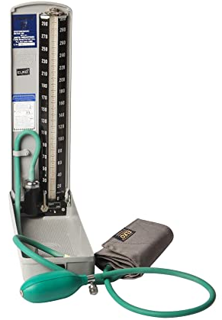
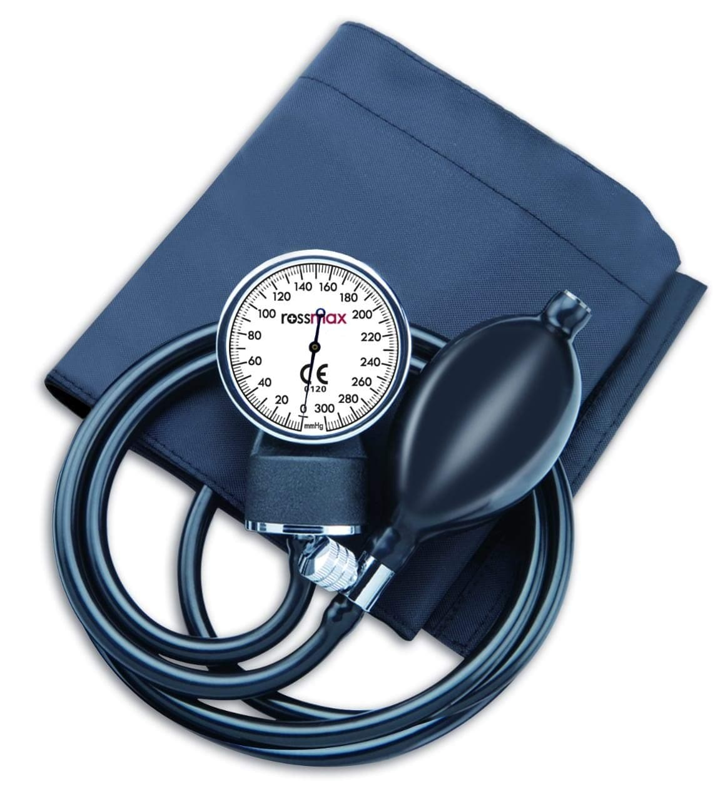
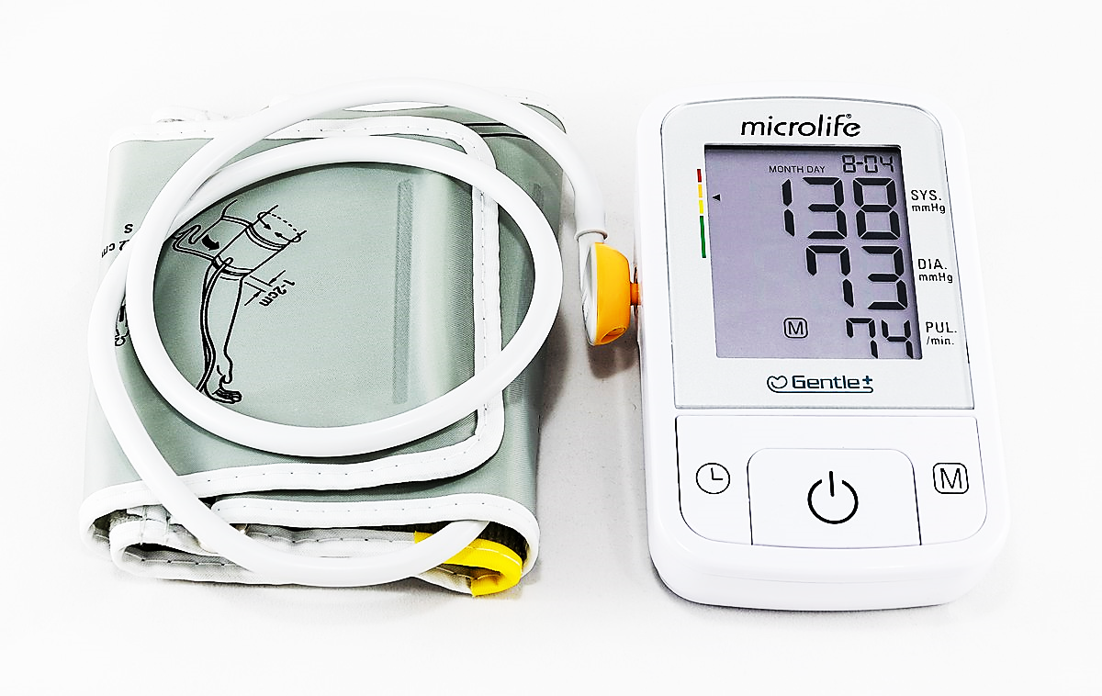
Sphygmomanometer
Fig a: Mercury based Sphygmomanometer
Fig b: Mechanical Sphygmomanometer
Fig c: Electronic Sphygmomanometer

Slide 7
Comparison between available Cuffless methods
Sr. No. | Principle | Description | Invasive/ Non-invasive
1 | PTT-based estimation | In this method, BP is estimated using pulse transit time (PTT). PTT refers to the time a pulse wave needs to travel between 2 arterial sites. | Non-Invasive
2 | Pulse contour method | It uses ballistocardiography and invasive central artery manometers to track mechanical events, | Invasive
3 | Acceleration PPG: second derivative analysis | The second derivative of the PPG (SDPPG) signal was analysed based on the amplitudes of waves a–e | Non-invasive
4 | Tonometry | In applanation tonometry of the radial artery, when a radial artery is partially compressed or splinted against a bone | Non-invasive
Table for principles discussed [3]

Slide 8
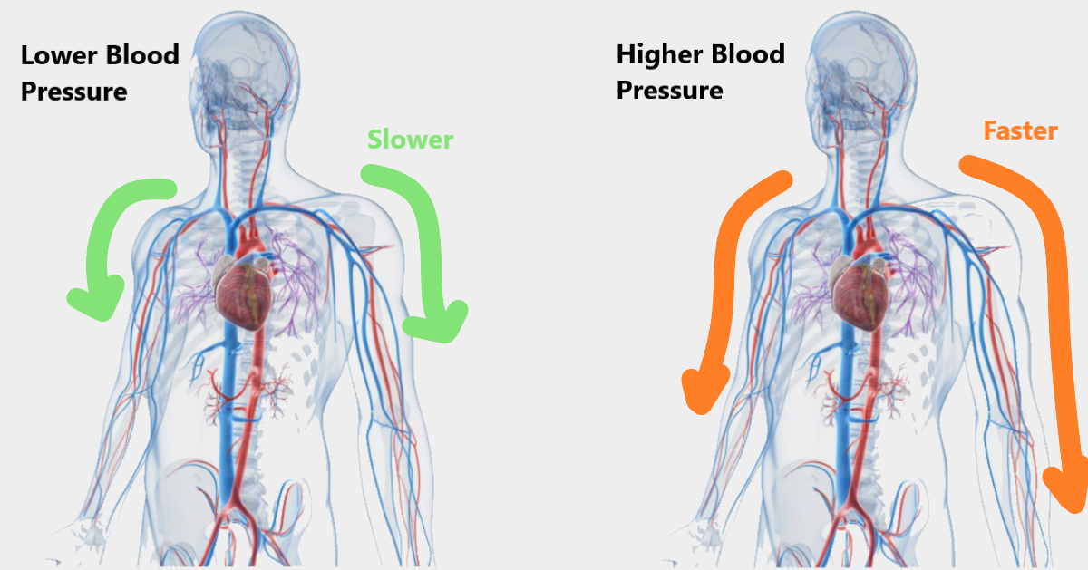
Principals
Pulse Wave Velocity (PWV) and Pulse Transit Time (PTT)
PTT
Time required to travel a pulse wave from one arterial site to another is referred as Pulse Transit Time
PWV
The velocity at which heart pulse travels is known as Pulse Wave Velocity
Pulse wave velocity is directly proportional to the
Blood pressure

Slide 9


Proposed System and working
Photo diode
Our used 2 identical PPG sensor
A PPG sensor works by illuminating a arterial area with LED and reflected light is captured by Photo diode.
The amount light going to absorb depends on the density of blood and density change due to heart beats. This way a heart beat is recorded as shown in fig a.
PPG sensors will collect data form 2 different arterial areas i.e. form finger tip of index finger from both left and right hand
Pulse Transit time (PTT) will be estimated form the data we got from PPG sensor which will further get used for BP estimation
LED
Fig a
Display
PPG
Sensor
Controller
PPG
Sensor
Input
Block diagram

Slide 10
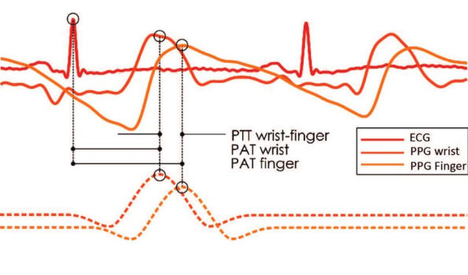
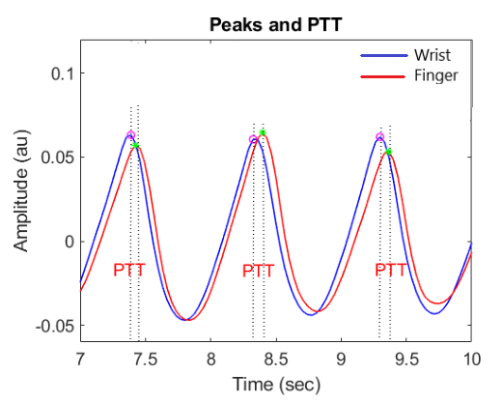
Calculating PTT
Collecting User inputs like data and when to start estimation
Collecting input from the PPGs located at wrist and finger at synchronous time
Fig PTT calculation based on the PPG waveform and ECG R wave [3]
3. Converting PPG signal in to digital by using onboard ADCs of Arduino, as shown in fig 4.1.1Calculation of PTT
4. BP estimation
5. Display and storing results
Fig PPT using PPG only [1]

Slide 11
Relation Between PTT and BP
BP = K1 * ${PTT}^{−1}$ + K2
Blood Pressure is inversely proportional PTT where,
K1 and K2 are the unknown individual-specific parameters.
linear regression model is been used to estimate BP before
MAE ± SD is 2.07 ± 2.06 mm Hg for SBP estimation, and 2.12 ± 1.85 mm Hg for DBP estimation has been achieved.
These estimates are Under the accurate BP estimation standard (5 ± 8 mmHg).

Slide 12

Data from verity of peoples
Fig: Different groups of people [4]

Slide 13
What our model proposes
As It is shown that these parameters are related to the individual’s age, height, and other physiological parameters variation
A Neural Network Regression Algorithm will predict the blood pressure using these parameters
Now we can include many more parameter for accurate prediction.
Chart: Changing blood pressure with changing height, weight and age

Slide 14
Expected Expenditure
COMPONENTS | COST (IN RS)
Raspberry Pi 3 | 2600
PPG sensor X 2 | 270
LCD module | 120
Push button X 4 | 40
Copper Wires | 50
Bread board | 70
Battery | 15
TOTAL | 3165 Rs

Slide 15
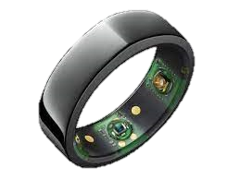
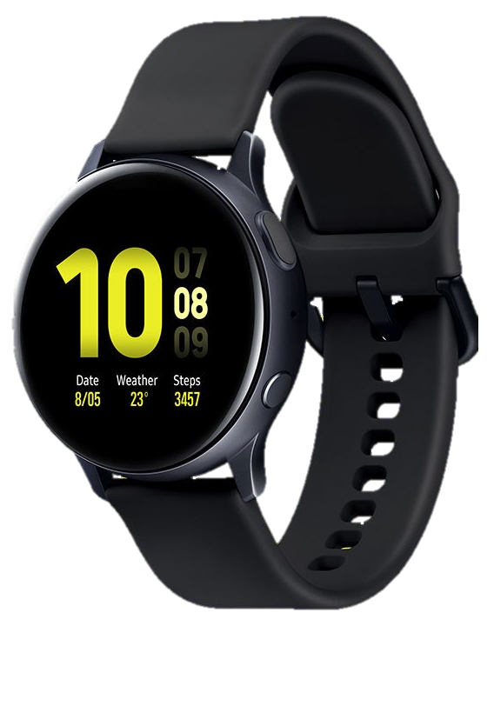
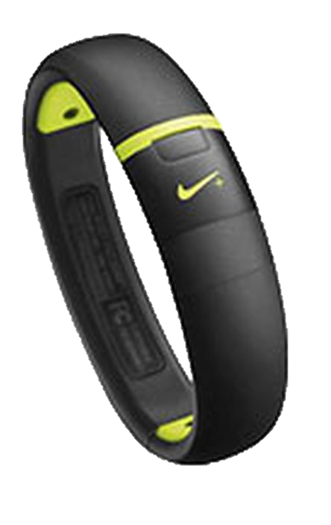
Disadvantages
Less accurate
Advantages and Application
Extremely Portable
AS portable it can be included into wearables using advance fabrication techniques.
Easy to use
So easy that individual can monitor their own blood pressure.
Though it is not very accurate but accurate enough to give a big idea before stroke or can prevent the progression of the hypertension and reduce medical costs

Slide 16
References
[1] IEEE Paper :
Fatemehsadat Tabei, Jon Michael Gresham, Behnam Askarian, Kwanghee Jung, Jo Woon Chong, “Cuff-Less Blood Pressure Monitoring System Using Smartphones”, IEEE, Digital Object Identifier 10.1109/ACCESS.2020.2965082, VOLUME 8, 2020
https://ieeexplore.ieee.org/document/8952635
[2] https://www.who.int/
[3] Conference paper:
Toshiyo Tamura, “Cuffless blood pressure monitors: Principles, standards and approval for medical use”, in IEICE Transactions on Communications · December 2020
[4] www.shutterstock.com

Slide 17
Thank you

Slide 18
Question ?

